Slide 1
Marketing & Retail Analytics

Slide 2
Problem Statement
Olist, an e-commerce company, has faced some losses recently and they want to manage their inventory very well so as to reduce any unnecessary costs. You have to manage the inventory cost of this e-commerce company OList.
Identify top products that contribute to the revenue
Use market basket analysis to analyze the purchase behavior of individual customers to estimate with relative certainty, what items are more likely to be purchased individually or in combination with some other products.

Slide 3
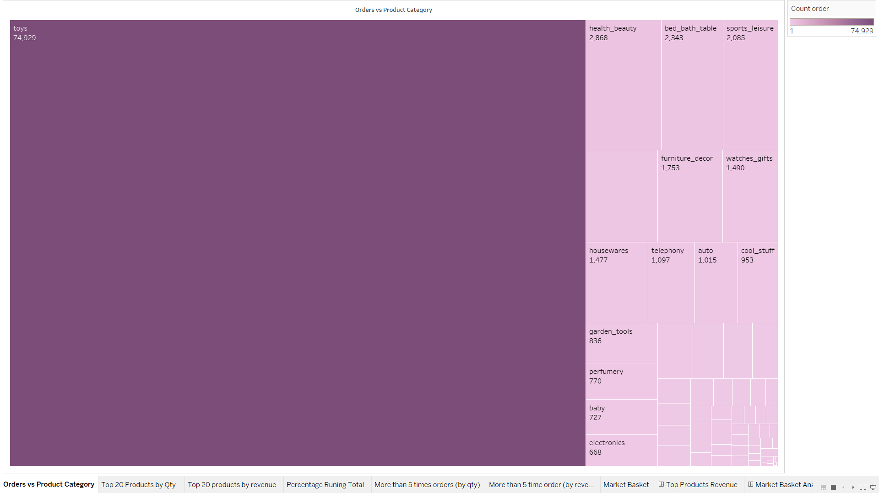
Orders VS Product Categories

Slide 4
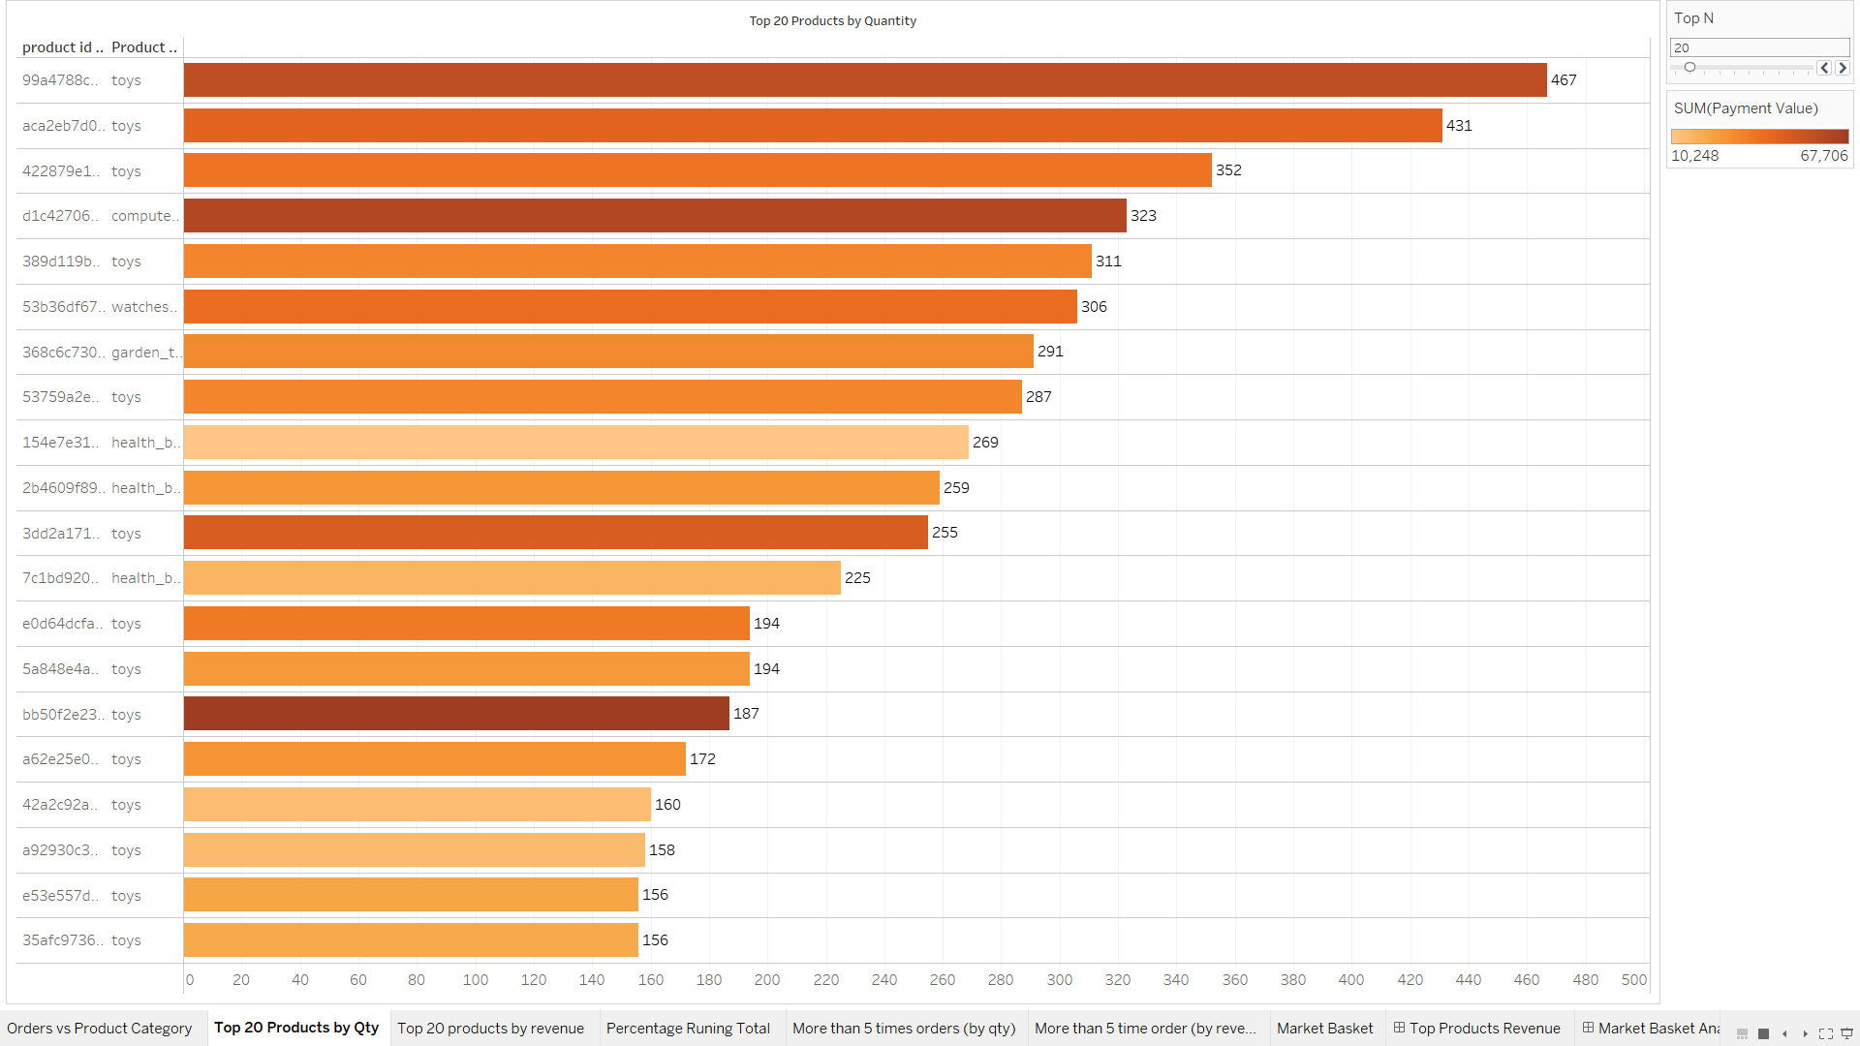
Top 20 Products (by Quantity)

Slide 5
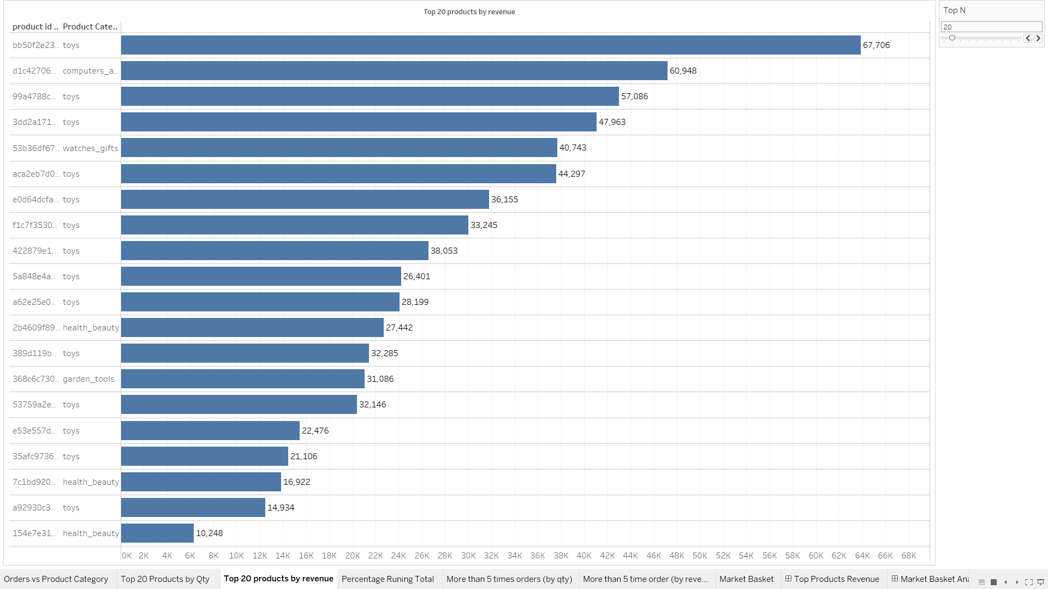
Top 20 Products (by Revenue)

Slide 6
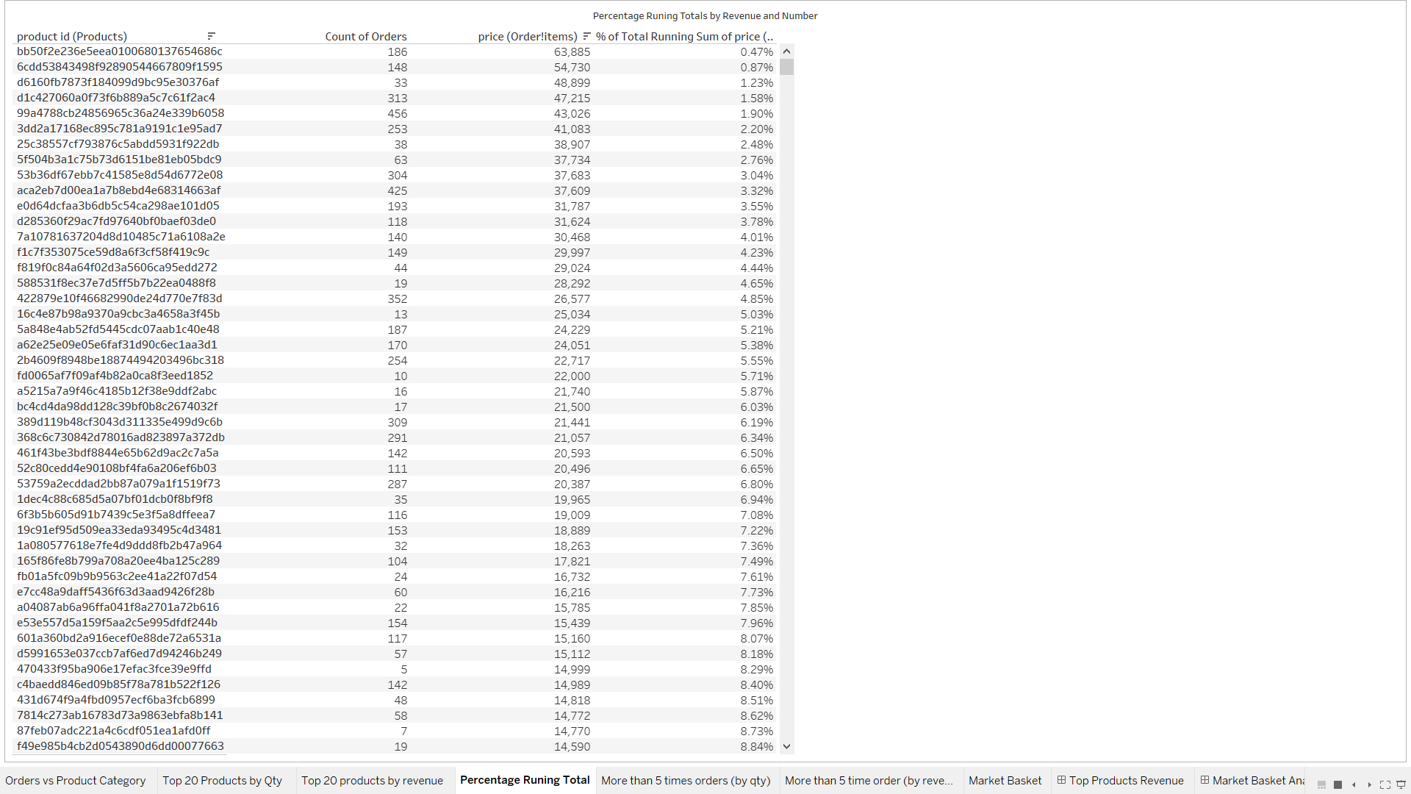
Percentage Running Totals by Revenue & No.

Slide 7
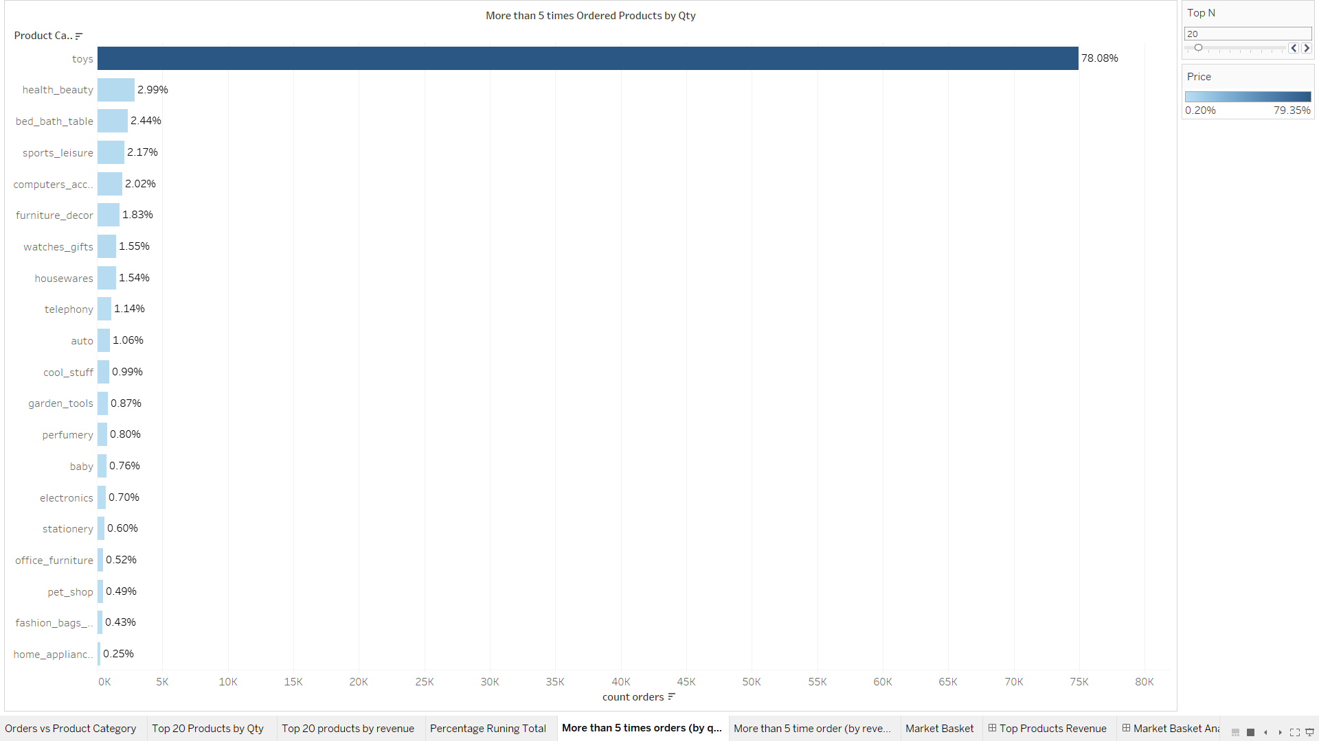
More than 5 times Ordered Products by Qty

Slide 8
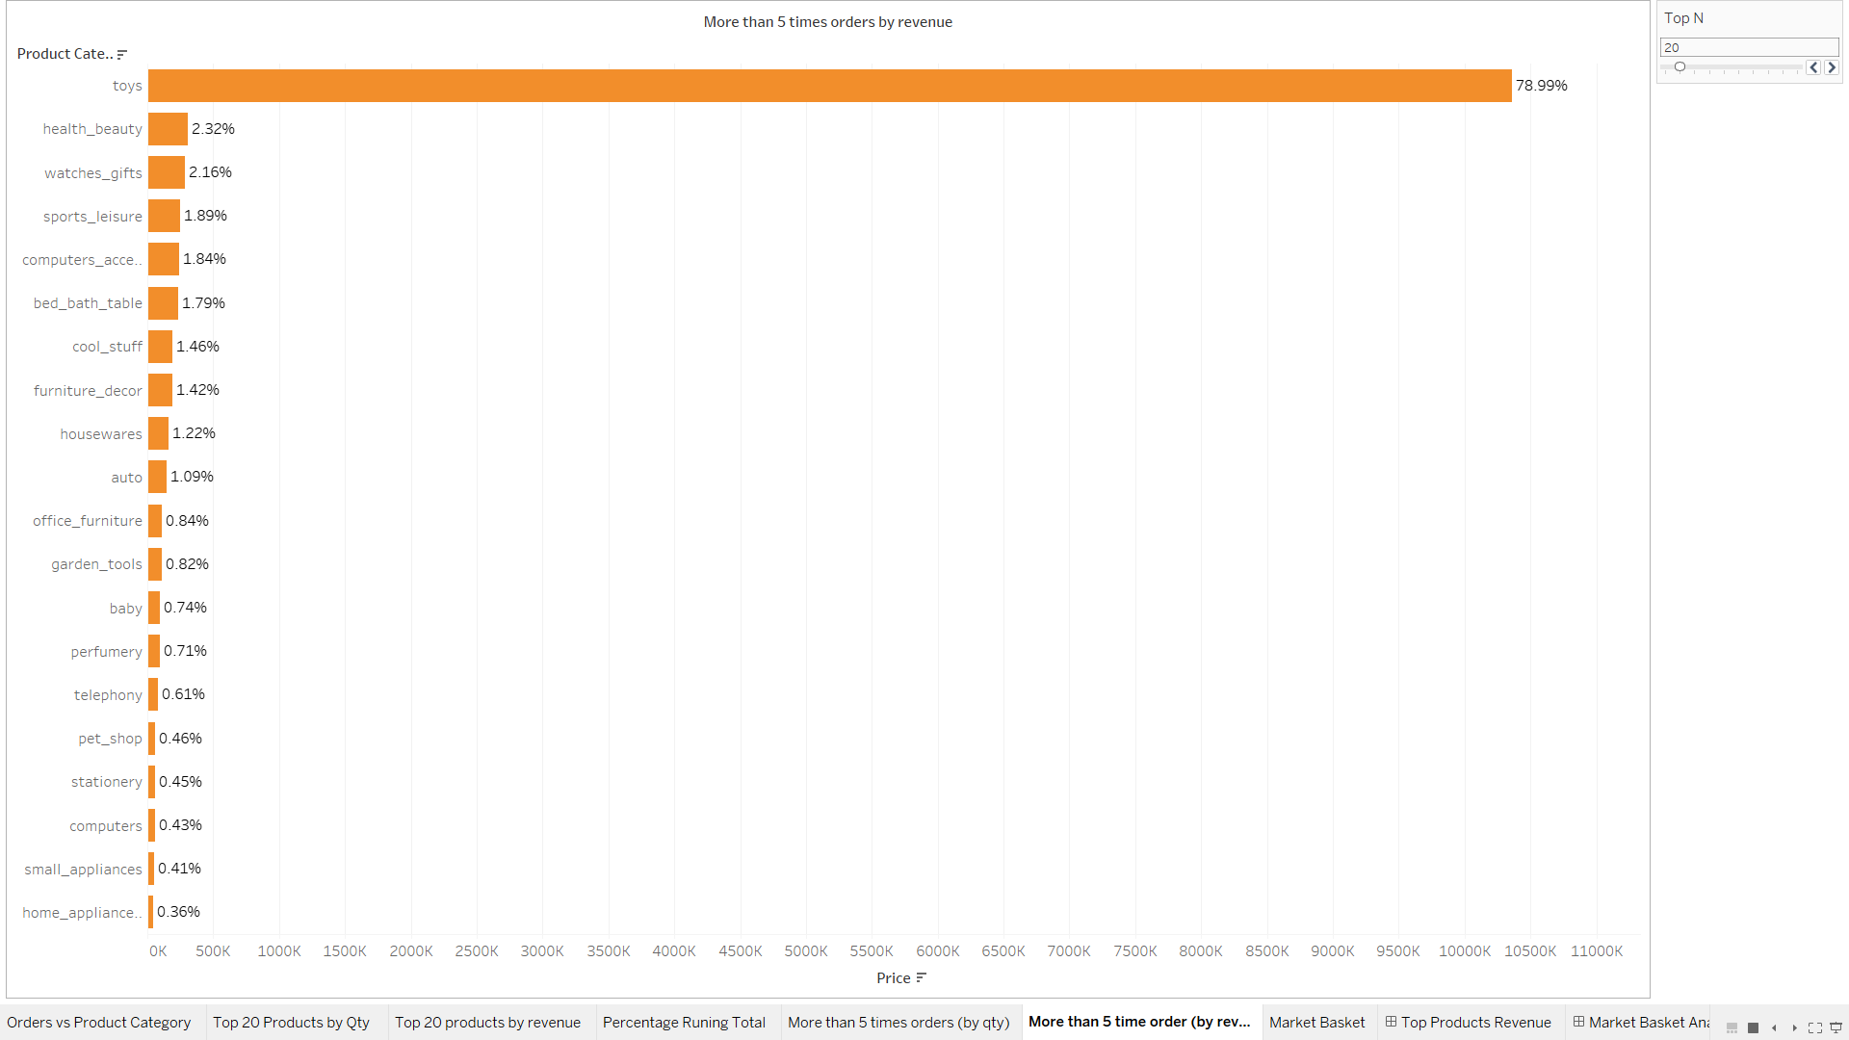
More than 5 times Ordered Products by Revenue

Slide 9
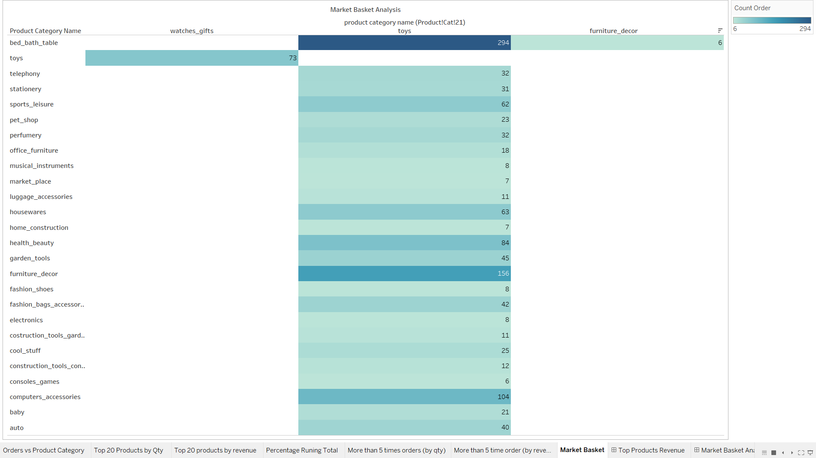
Market Basket Analysis

Slide 10
Insights
Among all product categories ‘toys’ is the most ordered product, that is, 74,929 times.
Apart from ‘toys’, categories like ‘health_beauty’, ‘bed_bath_table’, ‘sports_leisure’, ‘computer_accessories’ and ‘furniture_decor’ are the frequently ordered categories.
It was noted that in spite of high price, some products (like ‘toys’) are frequently sold.
From market basket analysis it was observed that with toys are most often purchased product with all other categories. However, ‘bed_bath_table’, ‘furniture_decor’, ‘computer_accessories’ and ‘health_beauty’ products are highly purchased with along ‘toys’.

Slide 11
Recommendations
Offer discounts or promo-codes on mostly ordered product categories or frequently ordered product combinations.
As ‘toys’ is ordered with all other product categories, target customer should be parents who can boost the sales.
The company should offer attractive discounts or coupons to the most frequent or loyal customers for retaining them.

Slide 12
Thank you

